Slide 1
Bayes Model to Bayesian Network
Unit 6
Fall 2021

Slide 2
References
Fenton, N. and M. Neil, Risk Assessment and Decision Analysis with Bayesian Networks, CRC Press, 2nd ed.2019 (F&N, 2019), Chap. 7, pp. 155-199
Pasman, Hans J., Risk Analysis and Control for Industrial Processes-Gas, Oil and Chemicals: A System Perspective for Assessing and Avoiding Low-Probability, High-Consequence Events, Elsevier, 2015
Bobbio, A., et al, “Improving the analysis of dependable systems by mapping fault trees into Bayesian networks,” Rel. Eng. and System Safety, 71 (2001) 249–260 (Bobbio, 2001)
Kjaerulff, U.B. and A.K. Madsen, Bayesian Networks and Influence Diagrams, Springer, 2008
Jensen, F.V. and T.D. Nielsen, Bayesian Networks and Decision Graphs, Springer, 2007
Nicholson, A., Bayesian Networks and Causal Modeling, School of Computer Science and Software Engineering, Monash University (Nicholson, Causal Modeling)
Korb, K.B. and A.E. Nicholson, Bayesian Artificial Intelligence, 2nd ed, Taylor & Francis, 2011 (Korb, 2011)
Michigan Chemical Process Dynamics and Controls Open Text Book (MCPDC)
Pearl, J., Probabilistic Reasoning in Intelligent Systems, Morgan Kaufmann, 1988 (Pearl, 1988)
Pearl, Judea, Causality: Models, Reasoning, and Inference, 2nd ed, Cambridge, 2009 (Pearl, 2009)
Neapolitan, R.E., Learning Bayesian Networks, Prentice Hall, 2004 (Neapolitan, 2004)
Neapolitan, R.E., Probabilistic Methods for Bioinformatics, Morgan Kaufmann, 2009

Slide 3
Advantages of BNs
We can explicitly model causes and effects, from effect to cause, Diagnostic reasoning, and cause to effect, Predictive reasoning, and the relative strength of causes, Intercausal reasoning, which are needed for engineering and science.
A BN can revise or overturn previous beliefs in the light of new evidence
BN is a logical framework for analyzing all types of data with diverse uncertainty levels, other information, with uncertainties including generic information, subjective expert judgment, and system specific data to support conditions for optimal, intuitive decision making.
Ability to make optimum predictions with the available data, usually incomplete data and often little or no hard data for which the uncertainties are propagated by the Bayes model.

Slide 4
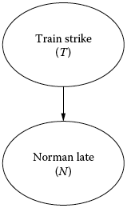
Risk Assessment Cause and Effect
Norman can arrive late to work, N, due to a direct cause Train strike, T.
We want to determine the probability of a train strike, given that we observe Norman is late to work, P(T|N)
An arc is directed from node ‘Train strike (T)’, (the uncertain cause) to node ‘Norman late (N)’ ( the observable effect).
We will use LTP for P(N) and Bayes Equation for P(T|N),
P(T)
Cause
Effect
P(N|T)
Observed System joint distribution: P(N,T)

Slide 5
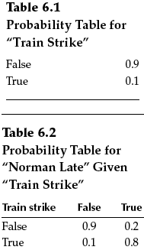
Risk Assessment Cause and Effect
Assume binary states: False/True
Prior Pr of Train strike: 0.1
So Pr of no strike is 1- 0.1 = 0.9
Pr of Norman being late when there is a train strike:
P(N = True|T = True) is 0.8.
Pr of Norman being late when there is no strike
P(N=True|T=False)= 0.1
The 2 values of the observable effect, ‘Norman late’, are “conditioned” on the 2 values of the cause, ‘Train strike’. So 4 values appear. These are shown in node N’s Conditional Probability Table (CPT)
Note that values for only one of the two redundant rows is required for the CPT.
Conditional
N late

Slide 6
Use LTP to determine Pr of Norman Late
Begin with the LTP to calculate denominator P(N) ( called Prior Predictive Probability):
P(N=True)=P(N=True|T=True)P(T=True)+P(N=True|T=False)P(T=False)
=(0.8×0.1)+(0.1×0.9) = 0.17
P(N=True) is the probability of Normal arriving late on any day
0.8
0.1
0.1
0.9

Slide 7
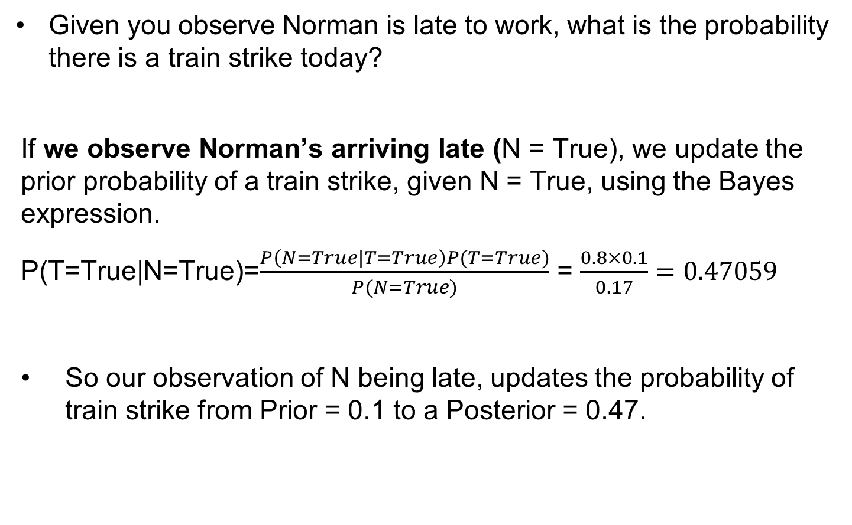
Use Bayes to Update the Pr of Train Strike
Given you observe Norman is late to work, what is the probability there is a train strike today?
If we observe Norman’s arriving late (N = True), we update the prior probability of a train strike, given N = True, using the Bayes expression.
P(T=True|N=True)=$\frac{P\left(N=True|T=True\right)P(T=True)}{P(N=True)}$ = $\frac{0.8×0.1}{0.17}=0.47059$
So our observation of N being late, updates the probability of train strike from Prior = 0.1 to a Posterior = 0.47.

Slide 8

Solve this:
What is the probability that there is no train strike even if you observe that Norman is late
.
P(N)=0.17
We want to find: P($\overline{T}$|N)

Slide 9
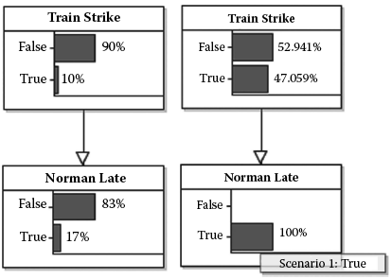
Prior and Posterior States Calculated in AgenaRisk
Prior
Posterior given ε
N: Norman late observed
P(T=False|N = True)
P(T=True|N = True)
Likelihood
P(N)^{c} = P(N = False)
N instantiated from observation
P(N = True)
Prior state of network (calculates the denominator using LTP)
Posterior (updated) state of network given observation: N = True (performs Bayesian calculation based on observation)

Slide 10
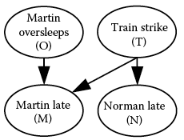
Account for Multiple Causes and Effects
Martin has a prior Pr = 0.4 of being late due to oversleeping, O. He, like Norman, is also more likely to be late given T, train strike.
The observable variable Martin late, M, therefore, has two direct causes (‘parent nodes’), as shown
To construct the BN, we need to build the Conditional Probability Table (CPT) first.
Common Effect

Slide 11
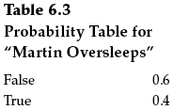
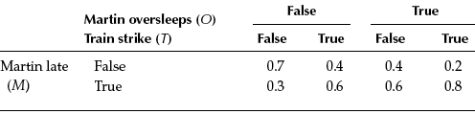
Account for Multiple Causes and Effects
⦁ The CPT of M (‘child node’) has 2³ values (2 values, conditioned on each of the 2 values of O, and on the 2 values of T)
Observed System joint distribution: P(N,M,O,T)
Table 6.4: CPT for Martin Late, M, conditioned on O and T

Slide 12
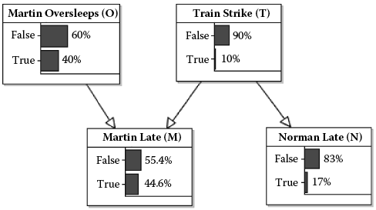
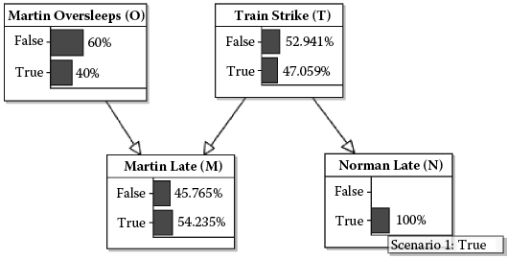
Prior State and Posterior State Given Observation
Increased
Increased
Prior marginal state of BN
Posterior revised state given observation of N
Effect of the observation that Norman is late (N = True) revises (increases) the probability that there is a train strike, T, and this in turn revises the probability for Martin late, M.
Also note that:

Slide 13
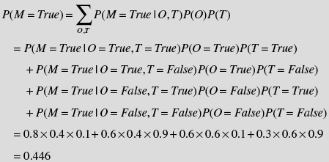
Calculation of Total Marginal Probability
Calculate the total marginal probability that P(M=True)
To assess the condition of a child node, you will have to consider ALL effects of ALL parent nodes
P(M) is conditioned on the cause variables Martin oversleeps (O) and Train strike (T). Marginalization removes variables O and T.
P(M)= ΣP(M|O,T)P(O,T) = ΣP(M|O,T)P(O)P(T)
O and T are assumed independent, so P(O,T) = P(O|T)P(T) = P(O)P(T)

Slide 14
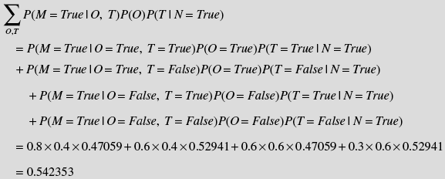
Revise P(M), Based on Observation of N=True
Use data previous results, and sum over all O, T to calculate
Note that T is conditional on N but O is NOT conditional on N.
So, P(O|N=True)=P(O)
P(M = True | N = True) =
0.47059
0.52941
(previously calculated
Posterior)
0.47059
⦁ Given the observation N = True, we obtain the revised marginal probability P(M=True|N = True) ~ 0.542
So, P(M=False|N = True) = 1– 0.542 = 0.458

Slide 15
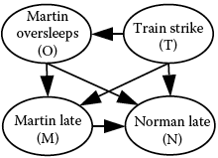
BN Conditional Independence Assumptions
The system function for the example BN we calculated is a joint probability distribution function of 4 variables, N, M, O, T: P(N,M,O,T). Note this function can be expanded into conditional function factors and a marginal factor using the Chain Rule for random variables:
Because the direct cause of N is T only, N is conditionally independent of M and O, P(N|M,O,T) = P(N|T). Also, O is independent of T, so P(O|T) = P(O). Therefore:

Slide 16
Three types of Bayesian Reasoning: Diagnostic, Predictive, and Intercausal
Evidence based on observation can be entered anywhere in the BN, and the evidence propagates throughout the network to update the marginal probabilities of the unobserved variables to support Diagnostic reasoning (identify causes), Predictive reasoning (predict effects), and Intercausal reasoning
Intercausal
Diagnostic
Predictive

Slide 17
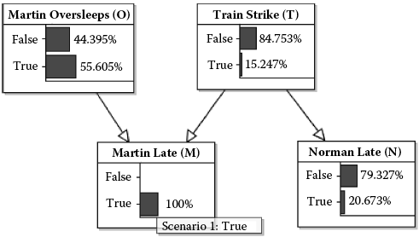
Evidence to Update Marginal Probabilities
MLE
Predictive
Diagnostic
Figure 6.5 a
If the observation that Martin = late is entered, the revised probabilities are shown in Fig 6.5 a, which shows that the Most Likely Explanation (MLE) for M (= True) is Martin Oversleeps (O), with P(O) = 0.55

Slide 18
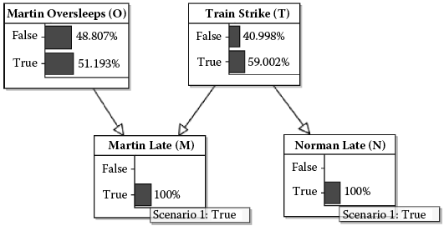
Evidence to Update Marginal Probabilities
Intercausal
MLE for M
Diagnostic
Figure 6.5 b
If the observation is entered that Norman too is late, however, the revised probabilities show in Fig 6.5b that the MLE for M (= True) is Train Strike (T = True), with posterior P(T|M=True, N=True) = 0.59, because N observation increases Pr of T.
This type of backward inferential reasoning to identify the primary cause of a common effect is called explaining away or intercausal reasoning.

Slide 19
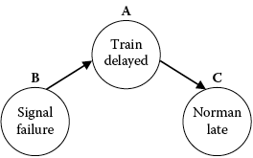
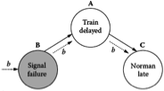
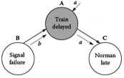
BN Structure: Serial Connection, Same Direction
The BN structure including the pattern of arcs dictates the info flow among the BN variables.
3 types of connection for information propagation: Serial, Diverging, or Converging
For a serial link (as in a Chain junction), the arcs are in one direction: Info about B increases belief in A, which increases belief in C
If the status of A is known or is instantiated (given a value), however, info about B is irrelevant to belief in C, because of evidence observed for A. So known A blocks the path for info flow between B and C.
Therefore, in a Serial Connection, B and C are conditionally independent given A.
info
info

Slide 20
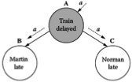
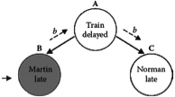
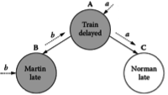
BN Structure: Diverging Connection: Common Cause
For a Diverging link (as in a fork junction), the arcs diverge from Common Cause A to B and A to C. Info about A increases belief in B and increases belief in C.
If no evidence is known about A, info about B influences belief in A and in C; also, info about C influences belief in A and in B. So, info flows through A to the B, C nodes.
If the status of A is known or is instantiated, however, info about B is irrelevant to belief in C, because of info about A. Therefore, known A blocks the path for info flow between B and A.
In a Diverging B and C are conditionally independent given A (similar to Serial connection)
info
Common Cause
info
info
info

Slide 21
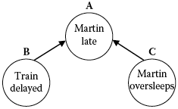

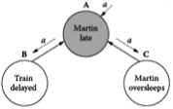
BN Structure: Converging Connection: Common Effect
For a Converging link (collider junction), the arcs converge to a Common Effect A from causes B and C. Info about B, Train delayed, or C, Martin oversleeps, influence belief in A about Martin being late
If no evidence is known about A, info about B has no relevance to C, and B is independent of info about C. The same is true for C independence of B. So, no evidence is transmitted through A.
If the status of A is known or is instantiated, info about cause B changes the belief in C and cause C in B, so C and B become conditionally dependent given A. If one of causes (C or B) is found ‘not true’, the other cause is more likely to be true (Intercausal Reasoning).
In a Converging Connection, evidence can be transmitted between the parent cause nodes only if there is evidence for A (Common Effect).
Common Effect
info

Slide 22
Review: BN Reasoning Types
Diagnostic reasoning is from symptom (effect) to cause in the opposite direction of the arcs. In the Cancer BN, the symptom Dyspnea is observed to update belief about the presence of Cancer and whether the patient is a Smoker.
Predictive reasoning is from new information about causes to beliefs about effects or symptoms in the direction of the arcs. A predictive reasoning example is learning that the patient is a smoker increases the belief that the patient has cancer prior to assessment of the patient’s symptoms.
Intercausal reasoning: relative weight of each of multiple causes based on the relative weight, amount, and quality of the data.

Slide 23
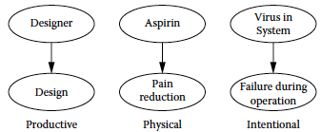
Cause-Consequence Idiom
Identify a productive, physical, or intentional relationship between cause and consequence
Also, look for a chronological order of the variables to indicate or infer cause and effect
The underlying causal process or mechanism, such as producing a design or taking an aspirin, is represented by the CPT (conditional probability table)
produces
leads to
inserted
Fig. 7.7 Cause-Consequence Instantiations (applications)

Slide 24
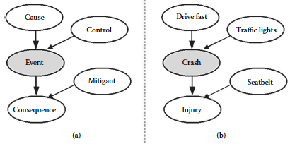
Basic Cause-Consequence Model
For reasoning about Risk, cause-consequence idiom instances can be combined for complex systems, such as use of the generic model below in Fig 7.9 (a) with 1 each of Cause, Control, Event, Consequence, and Mitigant.
Generic cause-consequence model
Car accident model
More complex models can have one or more of each of these variable types.

Slide 25
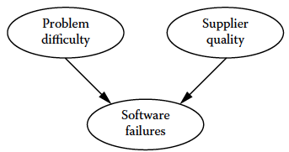
Intercausal Reasoning
For risk reasoning involving complex systems, cause-consequence idioms are joined together with shared input of output nodes for diagnostic (effect to cause) or predictive (cause to effect) reasoning
Cause 1
Cause 2
Review Intercausal Reasoning:
Causes are independent when there is no information for Common Effect, but the causes become conditionally dependent when effects (Software failures) are observed.
Common Effect
This is an example of predicting software failure frequencies based on information about problem difficulty and supplier quality. A high-quality supplier is more likely than a poor-quality supplier to release low failure software. The more difficult or complex the problem, however, the more likely that software will fail.

Slide 26
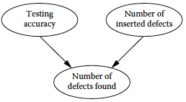
Measurement Idiom
unknown
Test a product for defects: Use the number of detected defects to represent the actual but unknown number of defects.
The measured number of defects found is dependent on the accuracy of the test and the actual number of inserted defects.
Note that from use of the measurement idiom, potentially false positive results, i.e. low number of defects found, can be explained away through inclusion of the testing accuracy node in the BN.
Lower/higher Testing accuracy reduces/increases confidence in the test result.

Slide 27
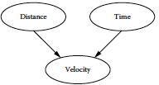
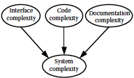
Definitional or Synthesis Idiom
This idiom is non-causal and is represented by several cases.
Case 1: Definitional relationships among variables
3 factors that define System complexity
Definition: Velocity = Distance/Time
System = Interface + Code + Documentation
The edge directions in this idiom indicate the direction in which sub-attributes define an attribute.

Slide 28
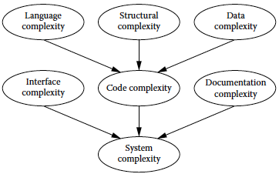
Definitional or Synthesis Idiom
Case 2: Hierarchical (multiple level) definitions to combine nodes for model clarity and to reduce number of parent nodes
Code = Language + Structure + Data
3-point scale
3 factors of Code complexity
3⁴ = 81
3 factors of System complexity
3⁴ = 81
System = Interface + Code + Documentation

Slide 29
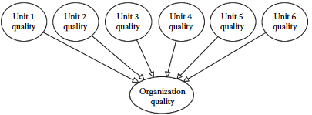
Definitional or Synthesis Idiom
Case 3: Combining nodes to reduce combinatorial explosion in the NPTs. The figure below shows an example of NPT explosion.
If quality is defined on a 3-point scale, the Organization quality NPT below will have 3⁷ or 2,187 cells.
Fig 7.24, Definitional idiom with flat hierarchy

Slide 30
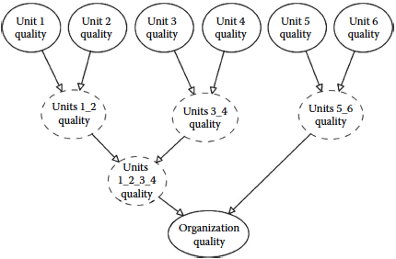
Divorcing Parents to Reduce
Combinatorial Explosion
Fig 7.24, Reorganization using Synthetic Nodes (‘divorcing’), where the largest NPTs have only 3³ = 27 cells with a 3-point scale
Parent nodes can realistically be separated from each other or divorced only when their effect, or influence on a Child node, can be considered separately and therefore independent from the other Parent nodes, which could be the case for this example.

Slide 31
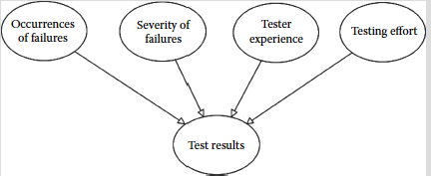
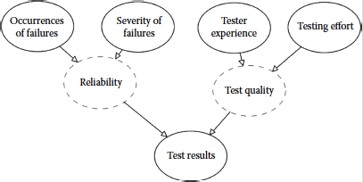
Divorce Parents: Reduce NPT & Increase Clarity
3⁵ = 243 values
Fig 7.28, Original BN without divorced parents
3³ = 27 values

Slide 32
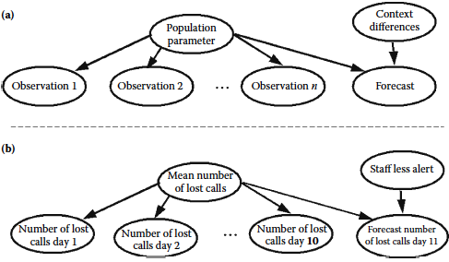
Induction Idiom
Learn, by Bayesian updating, about an unknown or partially known population parameter, such as a population mean, from observed data.
Generic model
Instantiated Induction Idiom model for a Call Center
Observations are used to update prior knowledge about population parameters, such as mean and variance. An example of context is that employees of a Call Center could be aware that they are being monitored (or not monitored) to check on lost calls and so work differently than usual, as an example of Observation Bias that affects the predicted Forecast.

Slide 33
Multiobject Bayesian Network Models
A BN model should not contain so many nodes that it lacks clarity and becomes conceptually difficult to understand as a system story based on the available data.
A BN model should not contain many similar repeated fragments.
For uncertainty modeling of more complex cases, the model can be disassembled and grouped into small component models, each one telling a story, called object-oriented BNs (OOBNs), which have input and/or output nodes that are the external interface for linking the OOBNs into an overall BN structure telling an overall story of the system.
^RDBN: 7.5, pp. 202-207

Slide 34
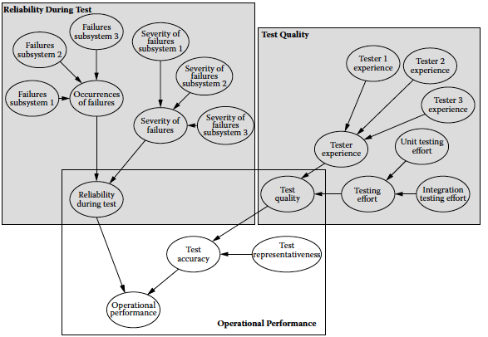
Performance Model: Decomposition for Clarity
Object 1: Reliability During Test
Object 2: Test Quality
Reliability during Test is an output node of the Reliability During Test Object and an input node of the Operational Performance Object. Similarly with the Test Quality node output of the Test Quality Object.

Slide 35
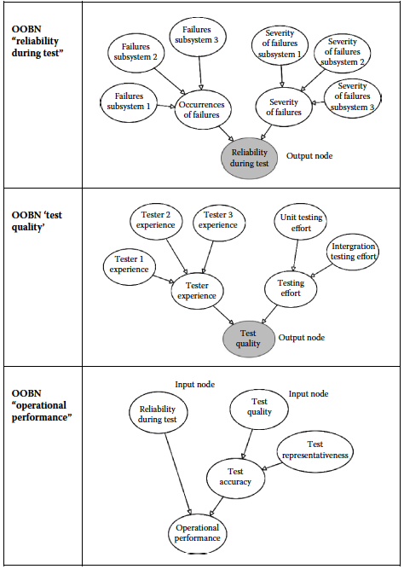
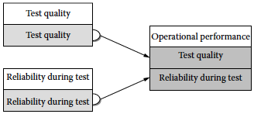
Object Oriented Bayesian Network
Fig 7.50, The three OOBNs of the larger model
object
object
output
input
Fig 7.51, Top-level view of the model showing the linking nodes in AgenaRisk

